Slide 1
EID 101D Smart Connected Devices
Navi-Bike
SangJoon (Bob), Lee
Jai, Himatsingka
Paul, Kang
Jimmy, Zhu
Chris, Jeong

Slide 2
The Original Pitch
500,000+ bicycles in NYC
Dangerous Navigation

Slide 3
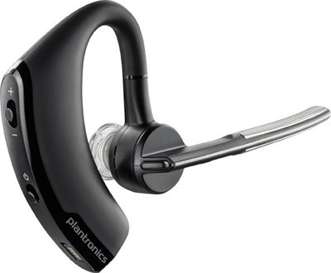
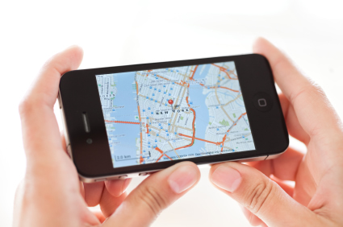

Slide 4
Customer Segments
International Tourists
Middle Class
18-45
Smartphone owners

Slide 5
Value Proposition
Pains:
No WiFi
Expensive Transportation
Safety

Slide 6
Value Proposition
Hotspot Wifi
Google Map
Crime Check
Rental
Gains:

Slide 7
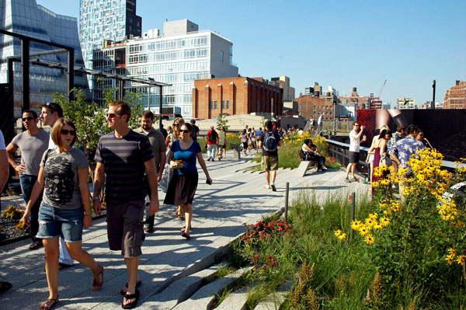
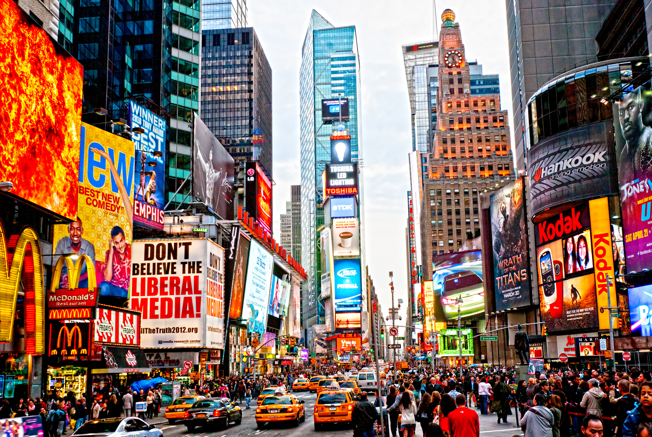
Interviews
High Line & Times Square

Slide 8
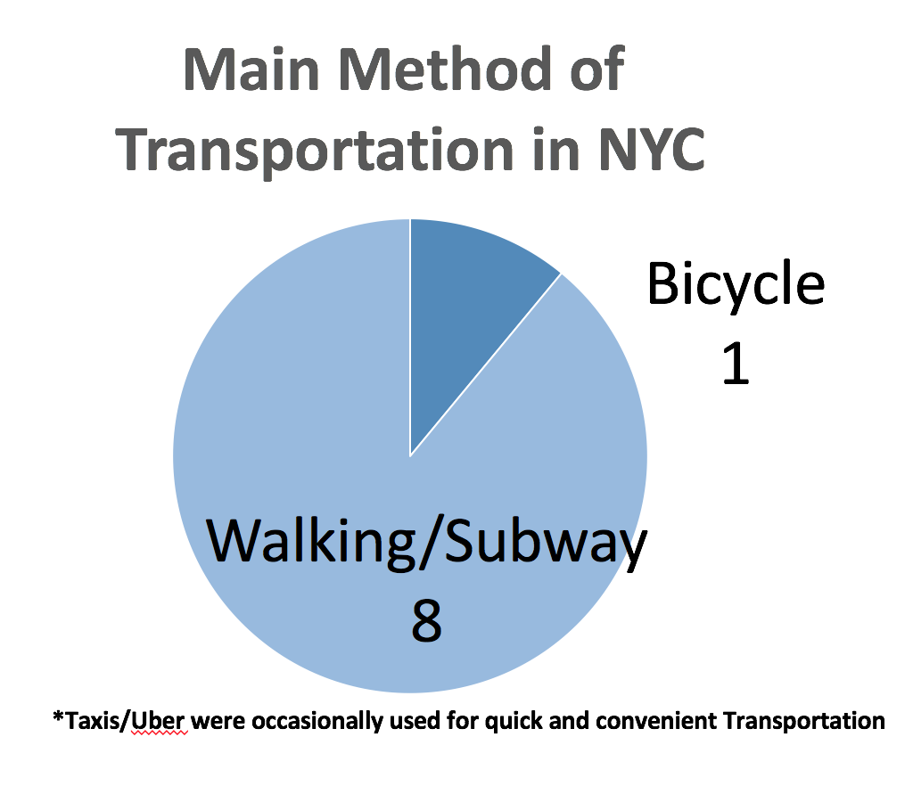

Slide 9
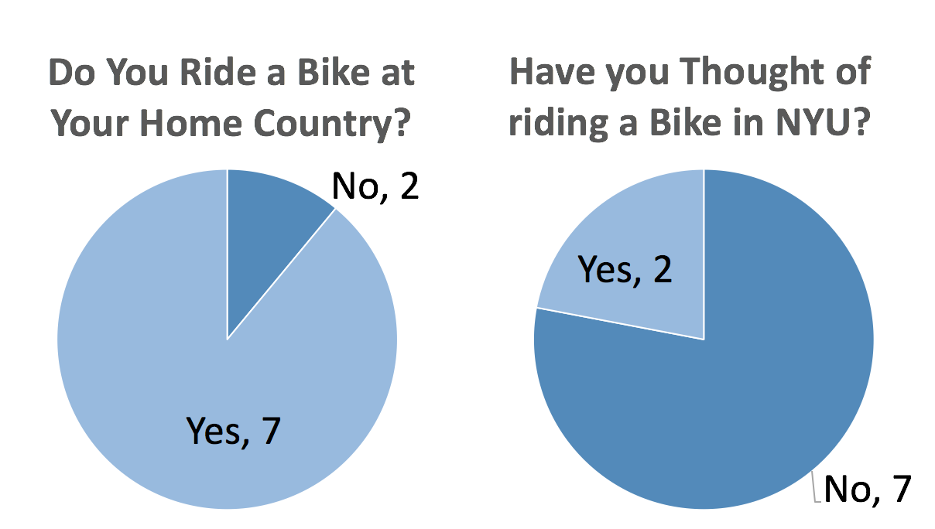

Slide 10

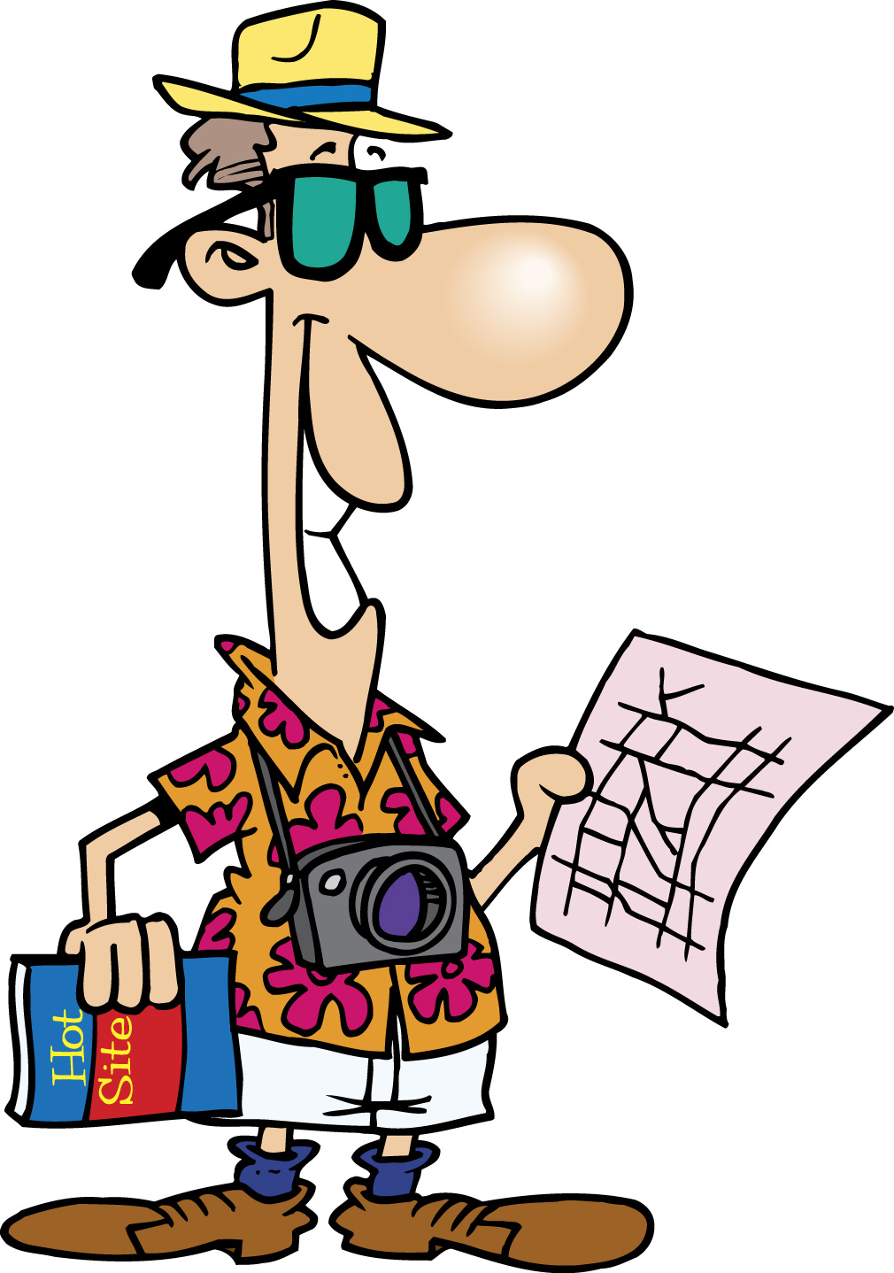
“Not enough bike lanes”
“Less fun, more stressful”
“Not familiar with NYC”
“Can’t take pictures”

Slide 11
Future plans
Interviews → Pain
Alternative Idea
Keep Searching

Slide 12
Thank you

